Slide 1


Noida Institute of Engineering and Technology, GR. Noida (An Autonomous Institute)
Introduction
Unit: 1
Computer Organization & Architecture (ACSE 0305)
Shikha Singh
Assistant Professor
NIET, Greater Noida
B Tech- 3rd Sem

Slide 2



Brief Introduction of Faculty member
Shikha Singh
Assistant Proffesor
Educational Qualification:-M. Tech (VLSI DESIGN)
B. Tech (ECE)
Paper Published: 2 (Conference)
Professional details:
Name of Institute with Code: NIET(133)
Designation: Assistant Professor
Department: ECE
Experience- 4 years

Slide 3
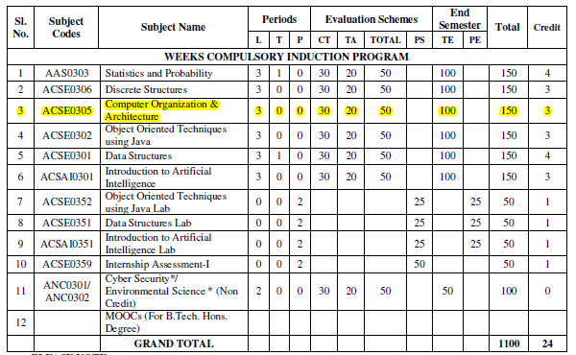
Evaluation scheme

Slide 4
Subject Syllabus
Course Contents / Syllabus
UNIT-I | Introduction | 8 Hours
Computer Organization and Architecture, Functional units of digital system and their interconnections, buses, bus architecture, types of buses and bus arbitration and it’s types. Register, bus and memory transfer. Process or organization, general registers organization, stack organization and addressing modes.
UNIT-II | ALU Unit | 8 Hours
Arithmetic and logic unit: Lookahead carries adders. Multiplication: Signed operand multiplication, Booth’s algorithm and array multiplier. Division and logic operations. Floating point arithmetic operation, Arithmetic & logic unit design. IEEE Standard for Floating Point Numbers.
UNIT-III | Control Unit | 8 hours
Control Unit: Instruction types, formats, instruction cycles and sub cycles (fetch and execute etc.), microoperations, execution of a complete instruction. Program Control, Reduced Instruction Set Computer, Complex Instruction Set Computer, Pipelining. Hardwire and microprogrammed control, Concept of horizontal and vertical microprogramming, Flynn's classification.

Slide 5
Subject Syllabus
Course Contents / Syllabus
UNIT-IV | Memory Unit | 8 hours
Memory: Basic concept and hierarchy, semiconductor RAM memories, 2D & 2 1/2D memory organization. ROM memories. Cache memories: concept and design issues & performance, address mapping and replacement Auxiliary memories: magnetic disk, magnetic tape and optical disks Virtual memory: concept implementation, Memory Latency, Memory Bandwidth, Memory Seek Time.
UNIT-V | Input/Output | 8 hours
Peripheral devices, I/O interface, I/O ports, Interrupts: interrupt hardware, types of interrupts and exceptions. Modes of Data Transfer: Programmed I/O, interrupt initiated I/O and Direct Memory Access. ,I/O channels and processors. Serial Communication: Synchronous & asynchronous communication.

Slide 6
Branch wise Applications
Computer Science:
Understanding of Computer Organization and Architecture is required for:
Performance analysis of practical software
Parallel Software and its execution
High performance databases
Modern Compilers and Code optimization
High performance game programming
Other applications
Bio-informatics, Data science using python, Web programming
For high performance computing, we require COA background.

Slide 7
Course Objective
Discuss the basic concepts and structure of computers.
Understand concepts of register transfer logic and arithmetic operations.
Explain different types of addressing modes and memory organization.
Understand the concepts of memory system and Learn the different types of memories to store data.
Explain the various types of interrupts and modes of data transfer.

Slide 8
Course Outcomes
Course outcomes : After completion of this course students will be able to
CO 1 | Understand the basic structure and operation of a digital computer system | K1, K2
CO 2 | Analyze the design of arithmetic & logic unit and understand the fixed point and floating-point arithmetic operations. | K1, K4
CO 3 | Implement control unit techniques and the concept of Pipelining | K3
CO 4 | Understand the hierarchical memory system, cache memories and virtual memory. | K2
CO 5 | Understand different ways of communicating with I/O devices and standard I/O interfaces. | K2

Slide 9
Program Outcomes
Program Outcomes are narrow statements that describe what the students are expected to know and would be able to do upon the graduation.
These relate to the skills, knowledge, and behavior that students acquire through the programmed.
Engineering knowledge
Problem analysis
Design/development of solutions
Conduct investigations of complex problems
Modern tool usage
The engineer and society
Environment and sustainability
Ethics
Individual and team work
Communication
Project management and finance
Life-long learning

Slide 10
CO-PO Mapping
 |  | COMPUTER ORGANIZATION AND ARCHITECTURE (ACSE 0305)
CO | PO1 | PO2 | PO3 | PO4 | PO5 | PO6 | PO7 | PO8 | PO9 | PO 10 | PO 11 | PO 12
CO1 | 3 | 2 | 1 | 1 | 1 | 1 | 1 | - | 1 | 1 | 1 | 2
CO2 | 2 | 2 | 2 | 2 | 1 | 1 | - | 1 | 1 | 1 | 1 | 2
CO3 | 3 | 2 | 2 | 1 | 2 | 2 | 1 | 1 | 2 | 2 | 1 | 2
CO4 | 3 | 2 | 2 | 2 | 2 | 1 | 1 | - | 1 | 1 | 1 | 2
CO5 | 2 | 2 | 2 | 1 | 2 | - | 1 | - | 1 | 2 | 2 | 2
Average | 2.6 | 2 | 1.8 | 1.4 | 1.6 | 1 | 0.8 | 0.4 | 1.2 | 1.4 | 1.2 | 2

Slide 11
Program Educational Objectives
PEO1: Solve real-time complex problems and adapt to technological changes with the ability of lifelong learning.
PEO2: Work as data scientists, entrepreneurs, and bureaucrats for the goodwill of the society and pursue higher education.
PEO3: Exhibit professional ethics and moral values with good leadership qualities and effective interpersonal skills.

Slide 12
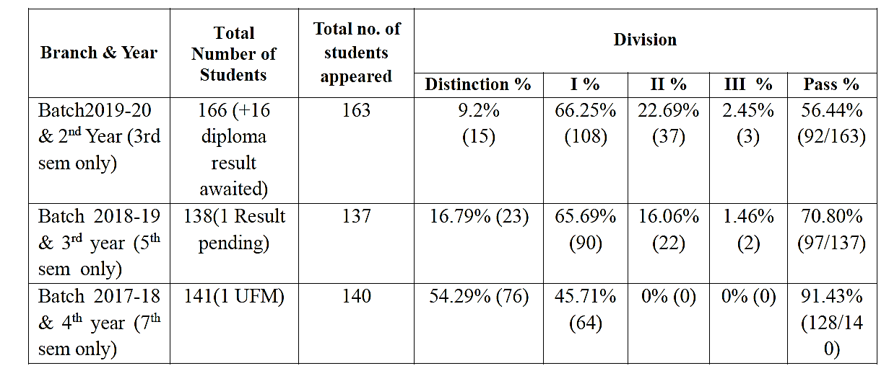
Result Analysis
Department Result
Individual Result
Computer Organization and Architecture | 100%
Renewable Energy Resources | 98.57%
Universal Human Values | 90.74%
Introduction to Microprocessor | 95.61%

Slide 13
End Semester Question Paper Template

Slide 14
Prerequisite and Recap
Basic knowledge of Digital Logic Design
ALU Unit
Control Unit
Memory unit

Slide 15
Brief Introduction about Subject
The Computer Organization and architecture is one of the most important and comprehensive subject that includes many foundational concepts and knowledge used in design of a computer system. This subject provides in-depth knowledge of internal working, structuring, and implementation of a computer system.
The COA important topics include all the fundamental concepts such as computer system functional units , processor micro architecture , program instructions, instruction formats , addressing modes , instruction pipelining, memory organization , instruction cycle, interrupts and other important related topics.
Video link: https://www.youtube.com/watch?v=q6oiRtKTpX4

Slide 16
Unit Content
Introduction
Functional units of digital system and their interconnections
Buses, bus architecture, Types of buses
Bus arbitration
Register, bus and memory transfer.
Processor organization
General registers organization
Stack organization
Addressing modes

Slide 17
Unit Objective
To understand the basic concepts and structure of computers.

Slide 18
Introduction to Topic 1
Name of Topic | Objective of Topic | Mapping with CO
Functional units of digital system and their interconnections | Students will be able to understand about different units of computer and how they are connected | CO 1

Slide 19
Introduction
Computer Organization and Architecture provides in-depth knowledge of internal working, structuring, and implementation of a computer system
Computer Architecture is concerned with the way hardware components are connected together to form a computer system.
Computer Organization is concerned with the structure and behaviour of a computer system as seen by the user.

Slide 20
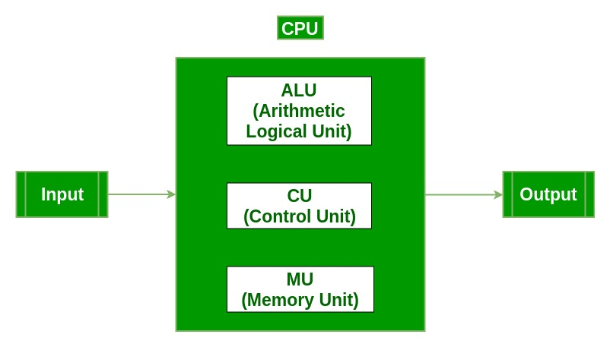
Functional Units of Computer System
Block Diagram

Slide 21
Functional Units of Computer System
Input Unit :
The input unit consists of input devices that are attached to the computer.
These devices take input and convert it into binary language that the computer understands.
Common input devices are keyboard, mouse, joystick, scanner etc.
Central Processing Unit (CPU) :
The CPU is called the brain of the computer because it is the control centre of the computer.
It first fetches instructions from memory and then interprets them so as to know what is to be done.
CPU executes or performs the required computation and then either stores the output or displays on the output device

Slide 22
Functional Units of Computer System
Arithmetic and Logic Unit (ALU) :
It performs mathematical calculations and takes logical decisions.
Arithmetic calculations include addition, subtraction, multiplication and division.
Logical decisions involve comparison of two data items to see which one is larger or smaller or equal.
Control Unit :
It coordinates and controls the data flow in and out of CPU and also controls all the operations of ALU, memory registers and input/output units.
It decodes the fetched instruction, interprets it and sends control signals to input/output devices until the required operation is done properly by ALU and memory.

Slide 23
Functional Units of Computer System
Memory :
Memory attached to the CPU is used for storage of data and instructions and is called internal memory.
The internal memory is divided into many storage locations, each of which can store data or instructions
Output Unit :
The output unit consists of output devices that are attached with the computer.
It converts the binary data coming from CPU to human understandable form.
The common output devices are monitor, printer, plotter etc.

Slide 24
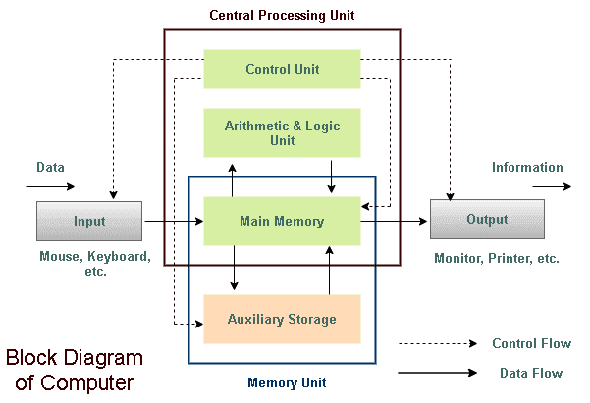
Interconnection of Functional unit

Slide 25
Memory
Primary / Main memory:
The memory unit that establishes direct communication with the CPU is called Main Memory. The main memory is often referred to as RAM (Random Access Memory).
It holds the data and instructions that the processor is currently working on.
Secondary Memory / Mass Storage:
The contents of the secondary memory first get transferred to the primary memory and then are accessed by the processor, this is because the processor does not directly interact with the secondary memory.
The memory units that provide backup storage are called Auxiliary Memory. For instance, magnetic disks and magnetic tapes are the most commonly used auxiliary memories.

Slide 26
Daily Quiz
______ is considered as the brain of the computer.
________ is smallest unit of the information.
_________ is the decimal equivalent of the binary number 10111.
_______ section is used to perform logic operations such as comparing, selecting, matching of data.
________ unit is used to store data and instructions.
The functions of sequencing and execution are performed by using
Input Signals
Output Signals
Control Signals
CPU
________ is a way in which the components of a computer are connected to each other.

Slide 27
Daily Quiz with Answers
______ is considered as the brain of the computer. ( CPU )
________ is smallest unit of the information? (Bit)
_________ is the decimal equivalent of the binary number 10111? (23)
_______ section is to perform logic operations such as comparing, selecting, matching, and merging of data? (ALU/Logic section )
_________ is used to store data and instructions. (Memory)
The functions of sequencing and execution are performed by using
Input Signals
Output Signals
Control Signals
CPU
________ is a way in which the components of a computer are connected to each other. (Computer Architecture)

Slide 28
Recap
Computer Organization and Architecture provides in-depth knowledge of internal working, structuring, and implementation of a computer system.
Computer Architecture is concerned with the way hardware components are connected together to form a computer system.
Computer Organization is concerned with the structure and behaviour of a computer system as seen by the user.
Computer consists of different blocks such as Input, output, Control unit, memory unit and ALU.

Slide 29
Introduction to Topic 2
Name of Topic | Objective of Topic | Mapping with CO
Buses, bus architecture, Types of buses | Students will be able to know the architecture and types of buses. | CO 1

Slide 30
BUS
BUS
A bus is a common pathway through which information flows from one computer component to another.
It is a subsystem that is used to transfer data and other information between devices.
Means various devices in computer like(Memory, CPU, I/O and Other) are communicate with each other through buses.

Slide 31
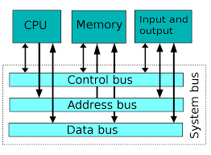
Bus Architecture

Slide 32
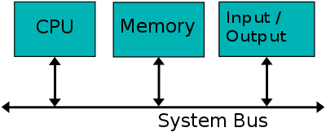
System Bus
A system bus is a single computer bus that connects the major components of a computer system, combining the functions of a data bus to carry information, an address bus to determine where it should be sent or read from, and a control bus to determine its operation

Slide 33
System Bus
Types of Computer BUS:
Data Bus
Address Bus
Control Bus

Slide 34
System Bus
Data bus
It is a bidirectional pathway that carries the actual data (information) to and from the main memory.
Data Lines provide a path for moving data between system modules.
It is bidirectional which means data lines are used to transfer data in both directions.
CPU can read data on these lines from memory as well as send data out of these lines to a memory location or to a port.
The no. of lines in data lines are either 8,16,32 or more depending on architecture.

Slide 35
System Bus
Address bus
Address Lines are collectively called as address bus.
It is a unidirectional pathway that allows information to travel in only one direction.
No. of lines in address are usually 16,20,24, or more depending on type and architecture of bus
It is an internal channel from CPU to Memory across which the address of data(not data) are transmitted.
It is used to identify the source or destination of data.
Here the communication is one way that is, the address is send from CPU to Memory and I/O Port but not Memory and I/O port send address to CPU on that line and hence these lines are unidirectional.

Slide 36
System Bus
Control bus
It carries the control and timing signals needed to coordinate the activities of the entire computer.
They are used by CPUs for Communicating with other devices within the computer.
They are bidirectional.
Typical Control Lines signals are
Memory Read
Memory Write
I/O Read
I/O Write ,etc

Slide 37
Bus Structure
Single Bus Structure –
All units are connected to the same bus.
Multiple Bus Structure
Traditional Configuration
Uses three buses – local bus, system bus and expanded bus.
High Speed BUS Configuration
Uses high speed bus along with three buses – local bus, system bus and expanded bus used in traditional configuration.

Slide 38
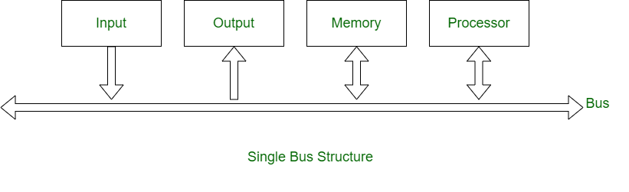
Single Bus Structure

Slide 39
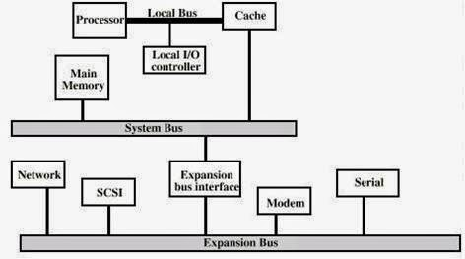
Traditional Bus Configuration

Slide 40
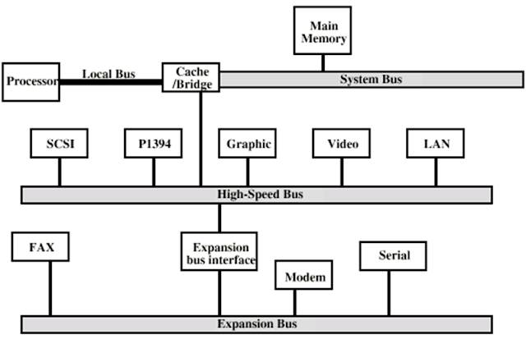
High Speed Bus Configuration

Slide 41
Daily Quiz
________ bus carries information between processors and peripherals.
_______ are unidirectional bus.
_________ bus controls the sequencing of read/write operations.
_____ is a common pathway through which information flows from one computer component to another.
Control bus is Unidirectional. T/F

Slide 42
Daily Quiz
________ bus carries information between processors and peripherals. (Data Bus)
_______ are unidirectional bus. (Address Bus)
_________ bus controls the sequencing of read/write operations. (Control Bus)
_____ is a common pathway through which information flows from one computer component to another. (Bus)
Control bus is Unidirectional. False

Slide 43
Recap
Bus Type | Description
Address bus | A unidirectional pathway – information can only flow one way
Data bus | A bi-directional pathway – information can flow in two directions
Control bus | Carries the control and timing signals needed to coordinate the activities of the entire computer

Slide 44
Introduction to Topic 3
Name of Topic | Objective of Topic | Mapping with CO
Bus arbitration | Students will be able to know the different schemes of bus arbitration | CO 1

Slide 45
Bus Arbitration
Bus Arbitration
It refers to the process by which the current bus master accesses and then leaves the control of the bus and passes it to the another bus requesting processor unit.
Bus master :The controller that has access to a bus at an instance.
Bus Arbiter: It decides who would become current bus master.

Slide 46
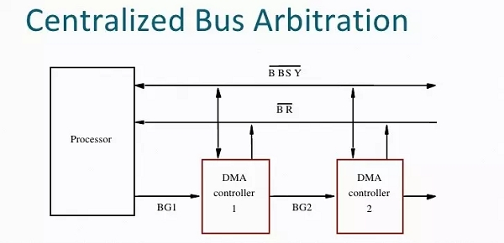
Bus Arbitration
There are two approaches to bus arbitration:
Centralized bus arbitration
A single bus arbiter performs the required arbitration and it can be either a processor or a separate DMA controller.

Slide 47
Bus Arbitration
Distributed bus arbitration
All devices participate in the selection of the next bus master.

Slide 48
Bus Arbitration
Methods of BUS Arbitration
There are three arbitration schemes which run on centralized arbitration.
Daisy Chaining method
Polling method
Independent Request method

Slide 49
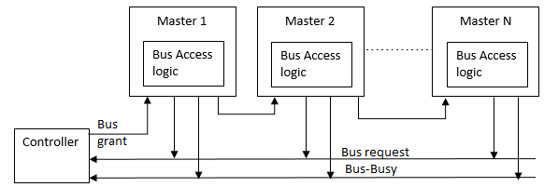
Daisy Chaining method

Slide 50
Daisy Chaining method
Advantages –
Simplicity and Scalability.
The user can add more devices anywhere along the chain
Disadvantages –
The value of priority assigned to a device is depends on the position of master bus.
Propagation delay is arises in this method.
If one device fails then entire system will stop working.

Slide 51
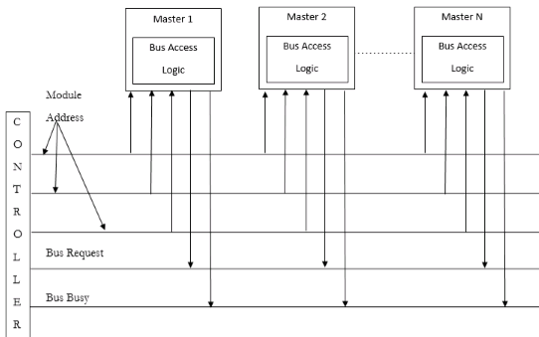
Polling or Rotating Priority Method

Slide 52
Polling or Rotating Priority Method
Advantages –
This method does not favor any particular device and processor.
The method is also quite simple.
If one device fails then entire system will not stop working.
Disadvantages –
Adding bus masters is difficult as increases the number of address lines of the circuit.

Slide 53
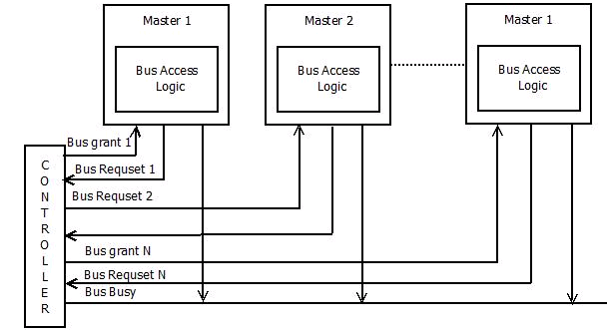
Fixed priority or Independent Request method

Slide 54
Fixed priority or Independent Request method
Advantages –
This method generates fast response.
Disadvantages –
Hardware cost is high as large no. of control lines are required.

Slide 55
Daily Quiz
To resolve the clash over the access of the system BUS we use ______ a) Multiple BUS b) BUS arbitrator c) Priority access d) None of the mentioned
The device which is allowed to initiate data transfers on the BUS at any time is called _____ a) BUS master b) Processor c) BUS arbitrator d) Controller
______ BUS arbitration approach uses the involvement of the processor. a) Centralised arbitration b) Distributed arbitration c) Random arbitration d) All of the mentioned

Slide 56
Daily Quiz with Answers
To resolve the clash over the access of the system BUS we use ______ a) Multiple BUS b) BUS arbitrator c) Priority access d) None of the mentioned
The device which is allowed to initiate data transfers on the BUS at any time is called _____ a) BUS master b) Processor c) BUS arbitrator d) Controller
______ BUS arbitration approach uses the involvement of the processor. a) Centralised arbitration b) Distributed arbitration c) Random arbitration d) All of the mentioned

Slide 57
Daily Quiz
When the processor receives the request from a device, it responds by sending _____ a) Request signal b) BUS grant signal c) Response signal d) None of the mentioned
Once the BUS is granted to a device ___________ a) It activates the BUS busy line b) Performs the required operation c) Raises an interrupt d) All of the mentioned
After the device completes its operation _____ assumes the control of the BUS. a) Another device b) Processor c) Controller d) None of the mentioned

Slide 58
Daily Quiz with Answers
When the processor receives the request from a device, it responds by sending _____ a) Request signal b) BUS grant signal c) Response signal d) None of the mentioned
Once the BUS is granted to a device ___________ a) It activates the BUS busy line b) Performs the required operation c) Raises an interrupt d) All of the mentioned
After the device completes its operation _____ assumes the control of the BUS. a) Another device b) Processor (After the device completes the operation it releases the BUS and the processor takes over it.) c) Controller d) None of the mentioned

Slide 59
Daily Quiz
The BUS busy line is used __________ a) To indicate the processor is busy b) To indicate that the BUS master is busy c) To indicate the BUS is already allocated d) None of the mentioned

Slide 60
Daily Quiz with Answers
The BUS busy line is used __________ a) To indicate the processor is busy b) To indicate that the BUS master is busy c) To indicate the BUS is already allocated d) None of the mentioned

Slide 61
Recap
Bus arbitration refers to the process by which the current bus master accesses and then leaves the control of the bus and passes it to the another bus requesting processor unit.
There are two approaches to bus arbitration: Centralized and Distributed
There are three arbitration schemes which run on centralized arbitration – Daisy chain, Polling and Independent request

Slide 62
Introduction to Topic 4
Name of Topic | Objective of Topic | Mapping with CO
Register, bus and memory transfer. | Students will be able to know transfer between the registers, bus and memory transfer | CO 1

Slide 63
Register, bus and memory transfer
Register
They are used to quickly accept, store, and transfer data and instructions that are being used immediately by the CPU.
They are used to hold the temporary data.
There are various types of Registers those are used for various purpose.
Register Symbol | Number of bits | Register Name | Register Function
DR | 16 | Data register | Holds memory operands
AR | 12 | Address register | Holds address for memory
AC | 16 | Accumulator | Processor register
IR | 16 | Instruction register | Holds instruction code
PC | 12 | Program counter | Holds address of instruction
TR | 16 | Temporary register | Holds temporary data
INPR | 8 | Input register | Holds input character
OUTR | 8 | Output register | Holds output character

Slide 64
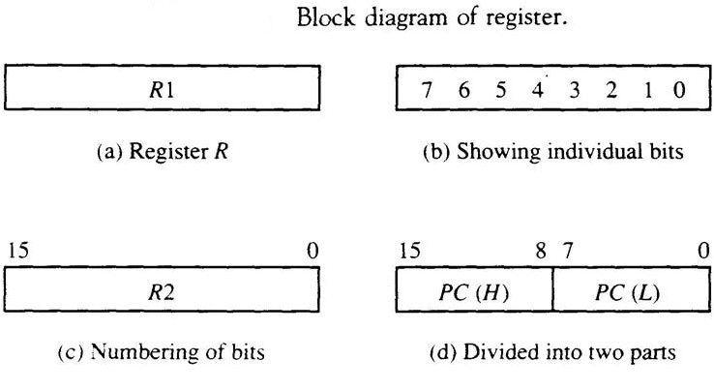
Register, bus and memory transfer
Register
Computer registers are designated by capital letters (sometimes followed by numerals) to denote the function of the register.
The register that holds an address for the memory unit is memory address register and is designated by the name MAR.
The program counter register is called PC, IR is the instruction register and R1 is a processor register

Slide 65
Register, bus and memory transfer
Register Transfer
Information transfer from one register to another is designated in symbolic form by means of a replacement operator.
R2 R1
It denotes a transfer of the content of register R1 into register R2. It designates a replacement of the content of R2 by the content of R1 without changing the content of R1 after transfer.
If the Register transfer is to occur only under a predetermined control condition, this can be shown by means of an if-then statement.
If (P = 1) then (R2 R1)
P: R2 R1, where P is a control function that can be either 0 or 1

Slide 66
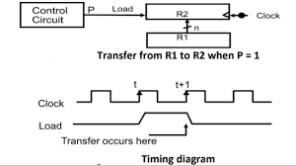
Register, bus and memory transfer

Slide 67
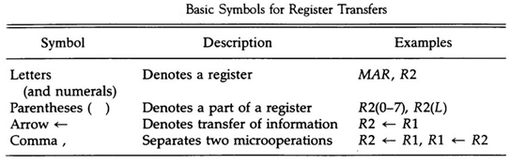
Register, bus and memory transfer

Slide 68
Register, bus and memory transfer
Bus transfer
A bus structure consists of a set of common lines, one for each bit of a register.
Control signals determine which register is selected by the bus during each transfer.
Multiplexers can be used to construct a common bus.
Multiplexers select the source register whose binary information is then placed on the bus.
The select lines are connected to the selection inputs of the multiplexers and choose the bits of one register

Slide 69
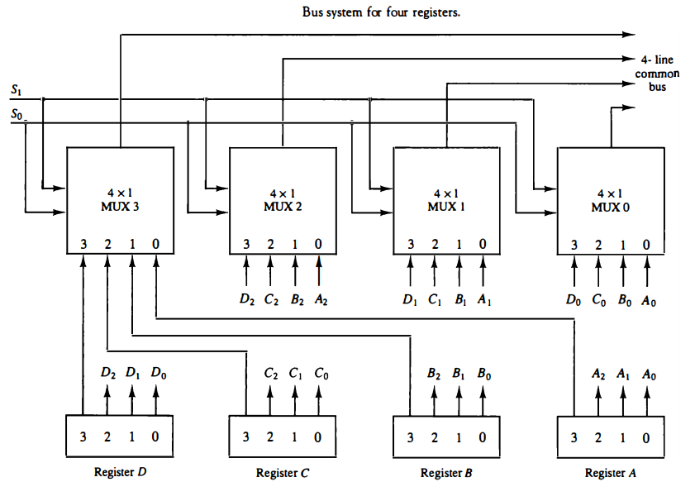
Register, bus and memory transfer
Bus system for 4 registers

Slide 70
Register, bus and memory transfer
Functional table for bus
S1 | S0 | REGISTER SELECTED
0 | 0 | A
0 | 1 | B
1 | 0 | C
1 | 1 | D

Slide 71
Register, bus and memory transfer
In general, a bus system will multiplex k registers of n bits each to produce an n- line common bus.
This requires n multiplexers – one for each bit
The size of each multiplexer must be k x 1
Transfer of information from the bus to one of many destination registers can be accomplished by connecting bus lines to the inputs of all designation registers and activating the load control of particular destination register selected.
Symbolic statement-
BUS C, R1 BUS,
If bus is known to exist in the system, R1 C

Slide 72
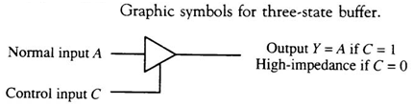
Bus Transfer using Three state buffer
Instead of using multiplexers, three-state gates can be used to construct the bus system
A three-state gate is a digital circuit that exhibits three states.
Two of the states are signals equivalent to logic 1 and 0
The third state is a high-impedance state – this behaves like an open circuit, which means the output is disconnected and does not have a logic significance.

Slide 73
Bus Transfer using Three state buffer
The three-state buffer gate has a normal input and a control input which determines the output state.
With control 1, the output equals the normal input
With control 0, the gate goes to a high-impedance state
This enables a large number of three-state gate outputs to be connected with wires to form a common bus line without endangering loading effects

Slide 74
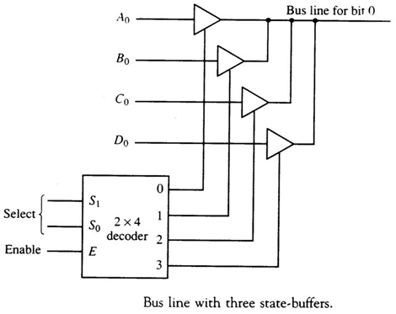
Bus Transfer using Three state buffer

Slide 75
Bus Transfer using Three state buffer
Decoders are used to ensure that no more than one control input is active at any given time
This circuit can replace the multiplexer.
To construct a common bus for four registers of n bits each using three-state buffers, we need n circuits with four buffers in each
Only one decoder is necessary to select between the four registers

Slide 76
Memory Transfer
Most of the standard notations used for specifying operations on memory transfer are stated below.
The transfer of information from a memory unit to the user end is called a Read operation.
A memory word is designated by the letter M.
We must specify the address of memory word while writing the memory transfer operations.
The address register is designated by AR and the data register by DR.
Thus, a read operation can be stated as:
Read: DR ← M [AR]
The Read statement causes a transfer of information into the data register (DR) from the memory word (M) selected by the address register (AR).

Slide 77
Memory Transfer
The transfer of new information to be stored in the memory is called a Write operation.
The Write statement causes a transfer of information from register R1 into the memory word (M) selected by address register (AR).
Write: M [AR] ← R1

Slide 78
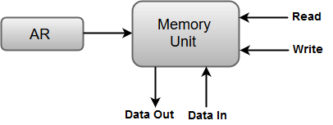
Memory Transfer
Memory Transfer Block diagram
Above Diagram showing connections to memory unit.
Write: M[AR] ← DR
Read: DR ← M[AR]

Slide 79
Daily Quiz
The transfer of information from a memory unit to the user end is called a _______operation.
_________ are used to quickly accept, store, and transfer data and instructions that are being used immediately by the CPU.
A decoder converts n inputs to __________ outputs. ()
Which of the following are building blocks of encoders? a) NOT gate b) OR gate c) AND gate d) NAND gate
The transfer of new information to be stored in the memory is called a _______ operation.
Which of the following can be represented for decoder? a) Sequential circuit b) Combinational circuit c) Logical circuit d) None of the mentioned

Slide 80
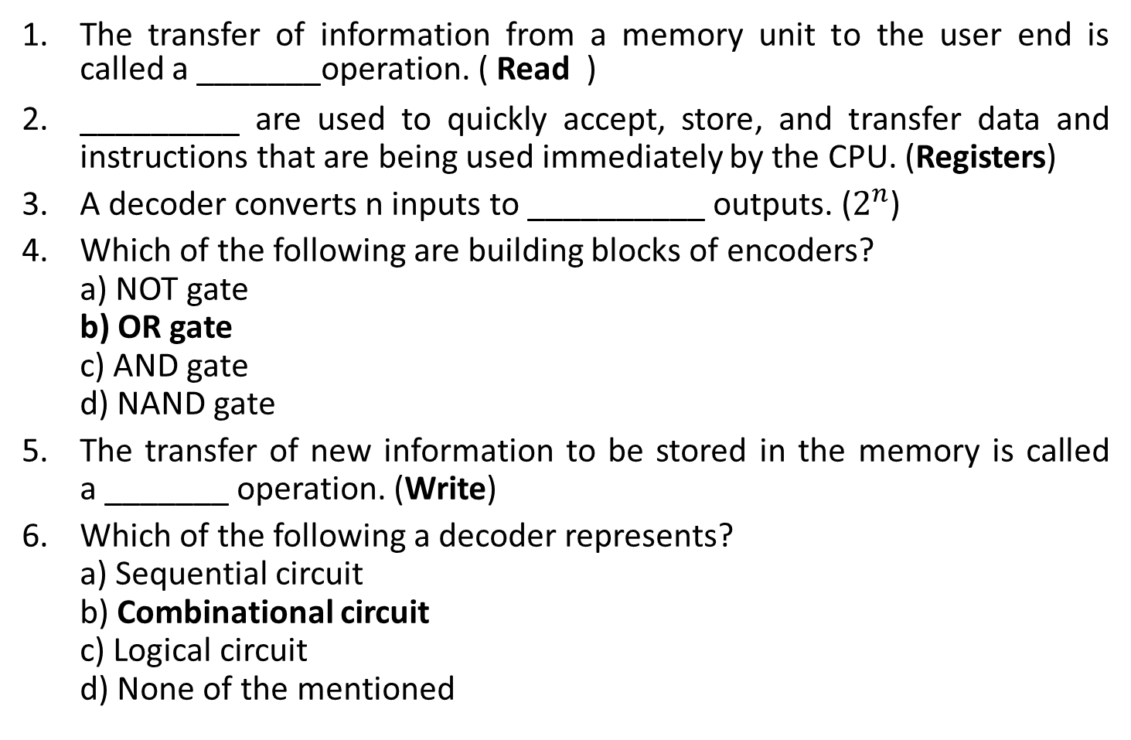
Daily Quiz with Answers

Slide 81
Recap
Registers are used to quickly accept, store, and transfer data and instructions that are being used immediately by the CPU.
Multiplexers can be used to construct a common bus.
A three-state gate is a digital circuit that exhibits three states – 0,1 and high impedance state.
The transfer of information from a memory unit to the user end is called a Read operation.
The transfer of new information to be stored in the memory is called a Write operation.

Slide 82
Introduction to Topic 5
Name of Topic | Objective of Topic | Mapping with CO
Processor organization, General register organization and stack organization | Students will be able to know various process organization and data stored in register and stack | CO 1

Slide 83
Registers
Registers are used to store data temporarily.
Registers
User Visible Register
Control & Status Register
General Purpose Register
Data Register
Address Register
Condition codes
Program counter
Instruction register
MAR
MDR

Slide 84
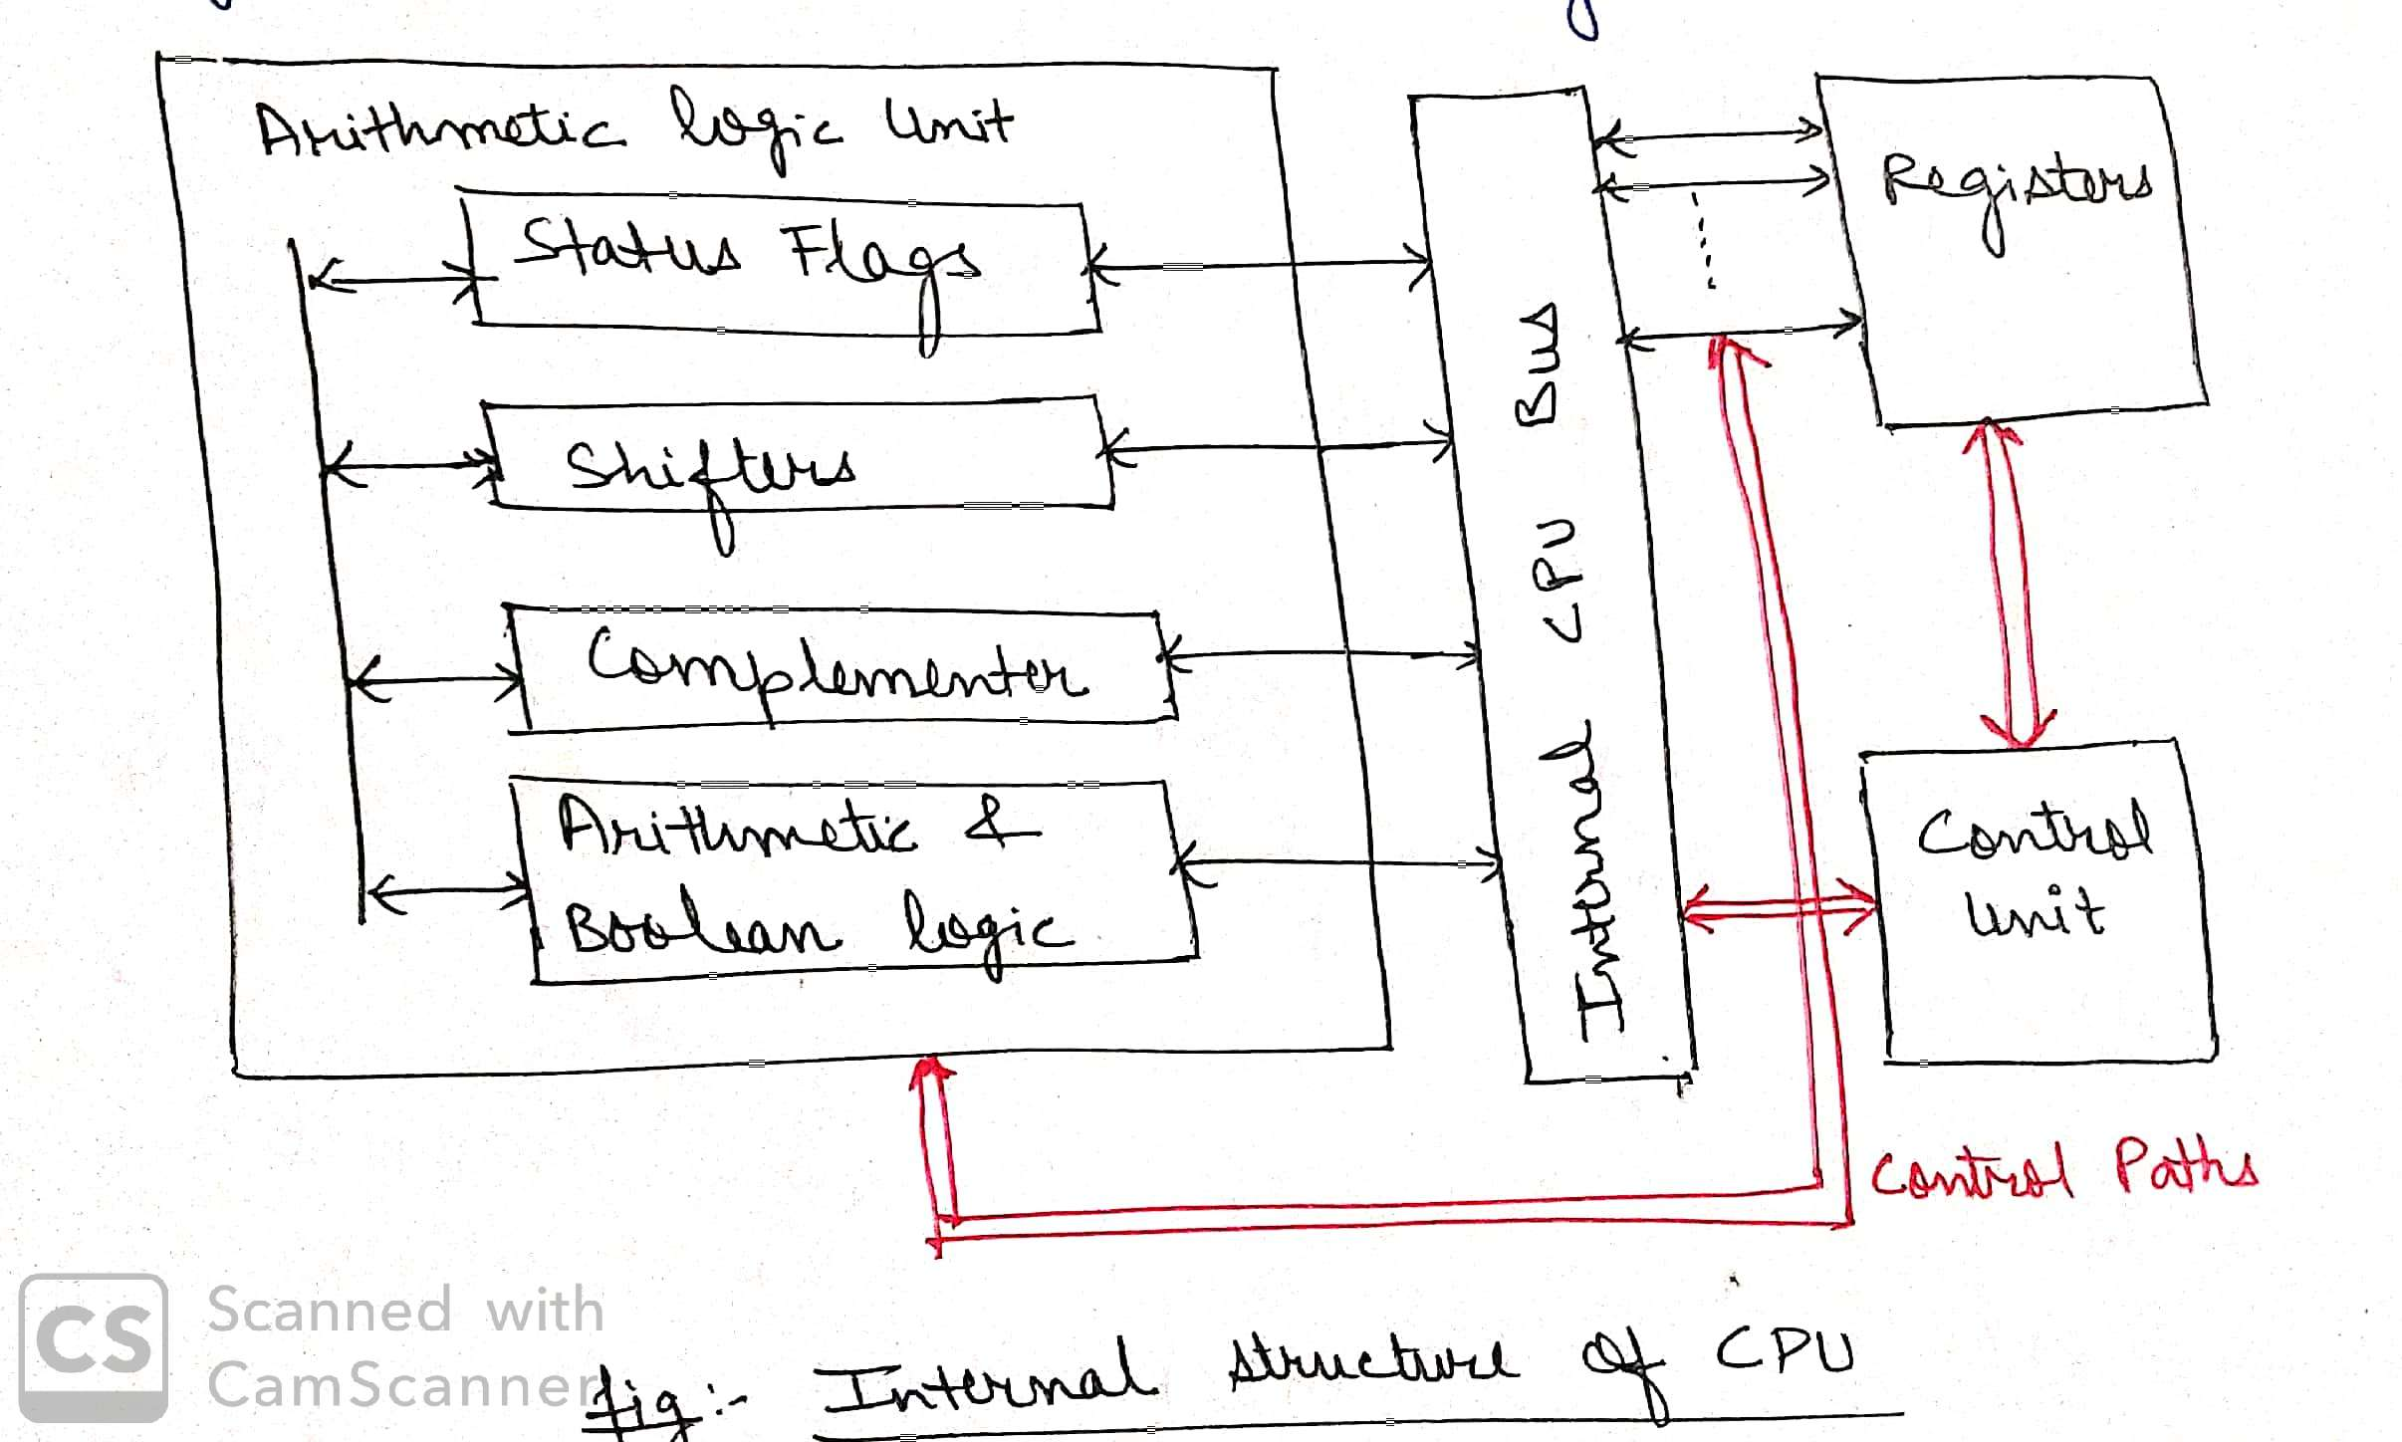
Processor organization
Processor organization means how the components of processor are connected and accomplish their task.

Slide 85
Processor organization-General register organization
Most computers fall into one of three types of CPU organizations:
Single accumulator organization.
General register organization.
Stack organization.
Single accumulator organization
The instruction format in this type of computer uses one address field.
All operations are performed with an implied accumulator register.
Example : ADD X
where X is the address of the operand. The ADD instruction in this case results in the operation AC <--AC + M[X].
AC is the accumulator register and M[X] symbolizes the memory word located at address X.

Slide 86
Processor organization
General register organization
The instruction format in this type of computer needs three register address fields.
ADD R1, R2, R3 to denote the operation R 1 <---R2 + R3 .
ADD R1, R2, would denote the operation R 1 <---R1 + R2. Only register addresses for R 1 and R2 need be specified in this instruction.
General register-type computers employ two or three address fields in their instruction format.
Each address field may specify a processor register or a memory word.
ADD R1, X
R1 ←---- R1 + M [X]

Slide 87
Processor organization
Stack organization
The stack-organized CPU ,Computers with stack organization would have PUSH and POP instructions which require an address field. Thus the instruction
PUSH X
It will push the word at address X to the top of the stack. Stack pointer is updated automatically.
ADD
This instruction in stack computer consists of an operation code only with no address field.

Slide 88
General register organization
General registers organization
In this type of organization, computer uses two or three address fields in their instruction format.
Each address field may specify a general register or a memory word. If many CPU registers are available for heavily used variables and intermediate results
For example:
MULT R1, R2, R3
This is an instruction of an arithmetic multiplication written in assembly language. It uses three address fields R1, R2 and R3.

Slide 89
General register organization
The meaning of this instruction is:
R1 <-- R2 * R3
This instruction also can be written using only two address fields as:
MULT R1, R2
In this instruction, the destination register is the same as one of the source registers. This means the operation
R1 <-- R1 * R2
The use of large number of registers results in short program with limited instructions.

Slide 90
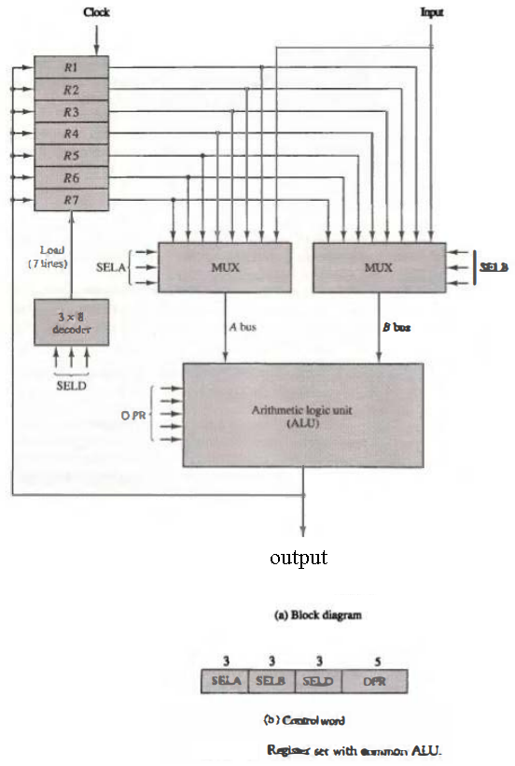
General register organization

Slide 91
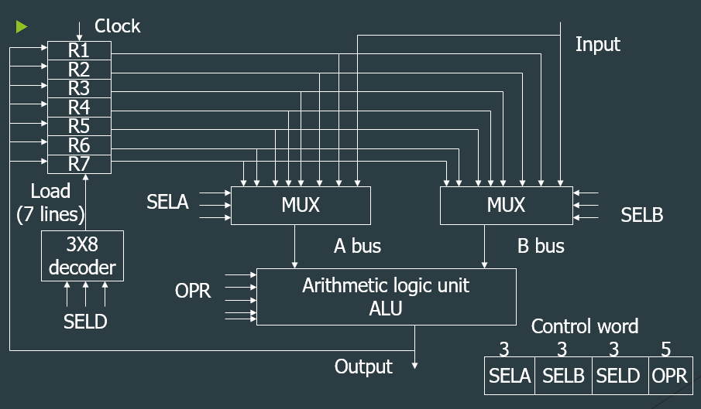
General register organization

Slide 92
Encoding of Register Selection Fields
Binary Code | SELA | SELB | SELD
000 | INPUT | INPUT | NONE
001 | R1 | R1 | R1
010 | R2 | R2 | R2
011 | R3 | R3 | R3
100 | R4 | R4 | R4
101 | R5 | R5 | R5
110 | R6 | R6 | R6
111 | R7 | R7 | R7

Slide 93
Encoding of ALU Operations
OPR Select | Operation | Symbol
00000 | Transfer A | TSFA
00001 | Increment A | INCA
00010 | Add A + B | ADD
00101 | Subtract A - B | SUB
00110 | Decrement A | DECA
01000 | AND A and B | AND

Slide 94
Example of Microoperations
Subtract microoperation:
R1 ←----- R2 – R3
Binary control word for subtract microoperation-
Field: | SELA | SELB | SELD | OPR
Symbol: | R2 | R3 | R1 | SUB
Control word: | 010 | 011 | 001 | 00101

Slide 95
General register organization
The control unit that operates the CPU bus system directs the information flow through the registers and ALU by selecting the various components in the system. For example, to perform the operation
R1 <--R2 + R3. The control must provide binary selection variables to the following selector inputs:
MUX A selector (SELA): to place the content of R2 into bus A .
MUX B selector (SELB): to place the content o f R 3 into bus B .
ALU operation selector (OPR): to provide the arithmetic addition A+B.
Decoder destination selector (SELD): to transfer the content of the output bus into R 1 .

Slide 96
General register organization
The advantages of General register based CPU organization
Efficiency of CPU increases as there are large number of registers are used in this organization.
Less memory space is used to store the program since the instructions are written in compact way.
The disadvantages of General register based CPU organization
Care should be taken to avoid unnecessary usage of registers. Thus, compilers need to be more intelligent in this aspect.
Since large number of registers are used, thus extra cost is required in this organization.

Slide 97
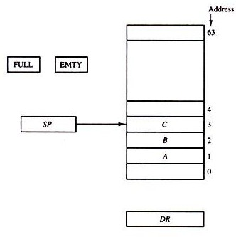
Stack Organization
A stack is a storage device that stores information in such a manner that the item stored last is the first item retrieved.
The stack in digital computers is essentially a memory unit with an address register that can count only. The register that holds the address for the stack is called a stack pointer (SP) because its value always points at the top item in the stack.
The physical registers of a stack are always available for reading or writing. It is the content of the word that is inserted or deleted.
Register stack:

Slide 98
Stack Organization
PUSH:
If the stack is not full (FULL =0), a new item is inserted with a push operation. The push operation consists of the following sequences of micro operations:
SP ← SP + 1 Increment stack pointer
M [SP] ← DR WRITE ITEM ON TOP OF THE STACK
IF (SP = 0) then (FULL ← 1) Check is stack is full
EMTY ← 0 Mark the stack not empty

Slide 99
Stack Organization
POP:
A new item is deleted from the stack if the stack is not empty (if EMTY = 0). The pop operation consists of the following sequences of micro operations:
DR ← M [SP] Read item on top of the stack
SP ← SP - 1 Decrement stack pointer
IF (SP = 0) then (EMTY ← 1) Check if stack is empty
FULL ← 0 Mark the stack not full
The top item is read from the stack into DR. The stack pointer is then decremented. If its value reaches zero, the stack is empty, so EMTY is set to 1.

Slide 100
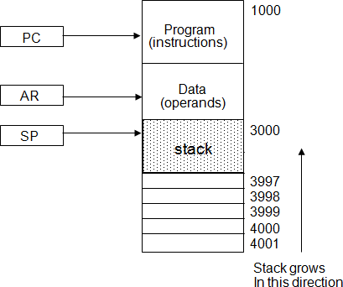
Stack Organization
Memory Stack
The implementation of a stack in the CPU is done by assigning a portion of memory to a stack operation and using a processor register as a stack pointer.

Slide 101
Stack Organization
Memory Stack
The program counter PC points at the address of the next instruction in the program which is used during the fetch phase to read an instruction.
The address registers AR points at an array of data which is used during the execute phase to read an operand.
The stack pointer SP points at the top of the stack which is used to push or pop items into or from the stack.
The three registers are connected to a common address bus, and either one can provide an address for memory.

Slide 102
Stack Organization
PUSH
A new item is inserted with the push operation as follows:
SP ← SP - 1
M[SP] ← DR
The stack pointer is decremented so that it points at the address of the next word.
A memory write operation inserts the word from DR into the top of the stack.
POP
A new item is deleted with a pop operation as follows:
DR ← M[SP]
SP ← SP + 1

Slide 103
Stack Organization
Polish Notation
A stack organization is very effective for evaluating arithmetic expressions. The common arithmetic expressions are written in infix notation, with each operator written between the operands.
Consider the simple arithmetic expression
A•B + C•D
A + B Infix notation
+AB Prefix or Polish notation
AB+ Postfix or reverse Polish notation (RPN)
The reverse Polish notation is in a form suitable for stack manipulation.
The expression A•B + C•D is written in reverse Polish notation as AB•CD•+

Slide 104
Daily Quiz
The Stack follows the sequence a) first-in-first-out b) first-in-last-out c) last-in-first-out d) last-in-last-out
The process of storing the data in the stack is called ……… the stack. a) pulling into b) pulling out c) pushing into d) popping into
The stack is useful for a) storing the register status of the processor b) temporary storage of data c) storing contents of registers temporarily inside the CPU d) all of the mentioned

Slide 105
Daily Quiz
The reverse process of transferring the data back from the stack to the CPU register is known as a) pulling out the stack b) pushing out the stack c) popping out the stack d) popping off the stack
Which of the following is not a visible register? a) General Purpose Registers b) Address Register c) Status Register d) MAR
Opcode indicates the operations to be performed. a) True b) False

Slide 106
Introduction to Topic 7
Name of Topic | Objective of Topic | Mapping with CO
Addressing Modes | Students will be able to know the different addressing modes. | CO 1

Slide 107
Addressing Modes
The addressing mode specifies a rule for interpreting or modifying the address field of the instruction before the operand is actually referenced.
The decoding step in the instruction cycle determines the operation to be performed, the addressing mode of the instruction, and the location of the operands

Slide 108
Addressing Modes
Implied mode:
The operands are specified implicitly in the definition of the instruction – complement accumulator or zero-address instructions.
CMA , CLC
Immediate mode:
The operands value are specified in the instruction.
Immediate mode instructions is said to be useful for initializing registers to a constant value.
MOV AL, 35 H
Register mode:
The operands are in registers and the register is present in CPU.
The data is in the register that is specified by the instruction.
MOV A,C (move the content of C register to A register)

Slide 109
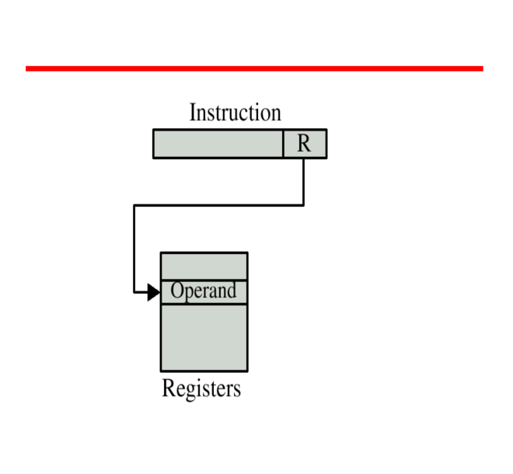
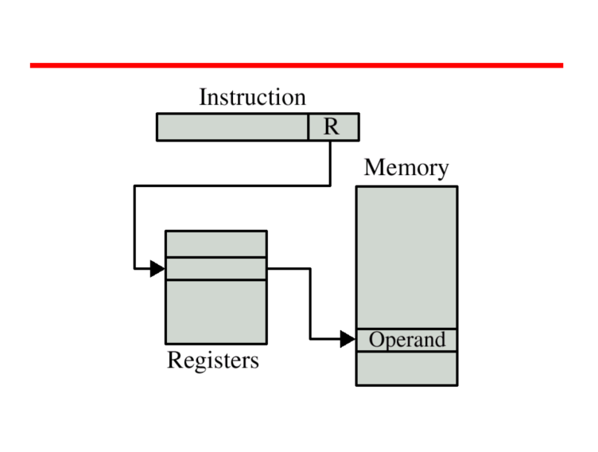
Addressing Modes
Register Addressing
Register Indirect Addressing

Slide 110
Addressing Modes
Register Indirect mode:
In this mode the instruction specifies a register in the CPU whose contents give the address of the operand in memory.
The selected register contains the address of the operand rather than the operand itself.
MOV AX,[CX] (move the content of memory location addressed by the register CX to the register AX)
Autoincrement/Autodecrement mode:
This is similar to register indirect mode except that the register is incremented or decremented after or before its value is used to access memory.
Increment mode- After accessing the operand the contents of this register are automatically incremented to point to next consecutive memory location.

Slide 111
Addressing Modes
Example: Add R1, (R2+)
OR
R1 = R1 + M[R2]
R2 = R2 + d
Useful for stepping through arrays in a loop.
R2 – start of the array, d- size of an element.
Decrement Mode:
Before accessing the operand , the contents of this register are automatically decremented to point to the previous consecutive memory location.
Example- Add R1, (-R2)
OR
R2 = R2 – d
R1 = R1 + M [R2]

Slide 112
Addressing Modes
Direct Address mode:
In this mode the effective address is equal to the address part of the instruction.
The operand resides in memory and its address is given directly by the address field of the instruction.
Example – ADD AL, [0301] (add the content of address 0301 to A)
Indirect Address mode :
In this mode the address field of the instruction gives the address where the effective address is stored in memory.
In this address field of instruction gives the address where the effective address is stored in memory.

Slide 113
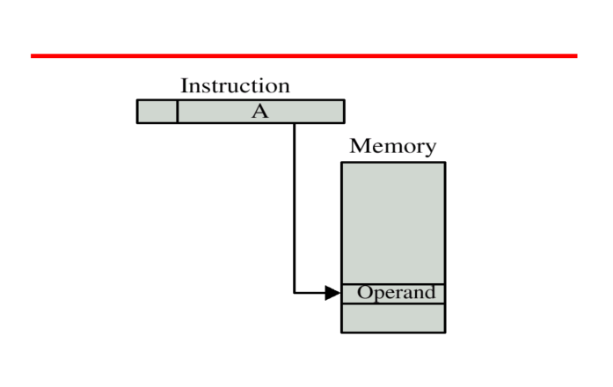
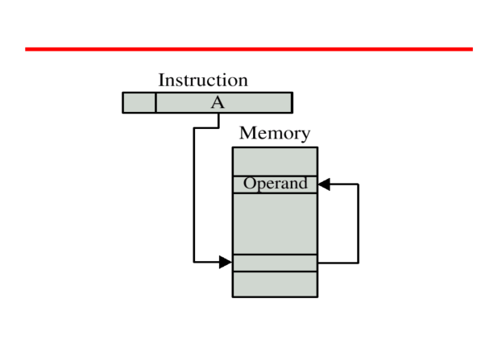
Addressing Modes
Direct Addressing
Indirect Addressing

Slide 114
Addressing Modes
Relative address mode: the effective address is the summation of the address field and the content of the PC
Indexed addressing mode: the effective address is the summation of an index register and the address field
Base register address mode: the effective address is the summation of a base register and the address field
effective address = address part of instruction + content of CPU register

Slide 115
Daily Quiz
1. RTL stands for:
a. Random transfer language
b. Register transfer language
c. Arithmetic transfer language
d. All of these
2. The register that includes the address of the memory unit is termed as the :
a. MAR
b. PC
c. IR
d. None of these
3. Which are the operation that a computer performs on data that put in register:
a. Register transfer
b. Arithmetic
c. Logical
d. All of these,,,,

Slide 116
Daily Quiz
4. Which operation puts memory address in memory address register and data in DR:
a. Memory read
b. Memory write
c. Both
d. None
5. A stack organized computer uses instruction of
a. Indirect addressing
b. Two addressing
c. Zero addressing
d. Index addressing

Slide 117
Daily Quiz
6. A flip flop is a binary cell capable of storing information of
a. One bit
b. One byte
c. Zero bit
d. Eight bits
7. To resolve the clash over the access of the system BUS we use ______ a. Multiple BUS b. BUS arbitrator c. Priority access d. None of the mentioned

Slide 118
Daily Quiz
8. The device which is allowed to initiate data transfers on the BUS at any time is called _____ a. BUS master b. Processor c. BUS arbitrator d. Controller

Slide 119
Weekly Assignment
Convert the following arithmetic expressions from infix to reverse polish notation
A*B+C*D+E*F
A* (B+C*CD+E)/F*(G+H)
Define System Bus. What are different bus structures?
What is general register organization?
Explain the various addressing modes with example.
What do you mean by processor organization? Explain various types of processor organization

Slide 120
Weekly Assignment
A digital computer has a common bus system for 16 registers of 32 bits each. The bus is constructed with multiplexers.
How many multiplexers are there in the bus?
What size of multiplexers are needed?
How many selection inputs are there in each multiplexer?
Draw basic functional units of a computer with interconnection.
Draw a block diagram of 64 word Register stack and write sequence of microoperations for PUSH and POP operation.
Discuss the advantages and disadvantages of Daisy Chain and Polling bus arbitration schemes.
What is control word? Specify the control word for subtract microoperation given in the statement –
R1 ←------ R2 – R3

Slide 121
Topic Links
Types OF Buses-
https://www.youtube.com/watch?v=xBYhHC8_A6o&list=PLxCzCOWd7aiHMonh3G6QNKq53C6oNXGrX&index=4
Common bus system using multiplexer
https://www.youtube.com/watch?v=nbDd46e_LpE&list=PLxCzCOWd7aiHMonh3G6QNKq53C6oNXGrX&index=5
Single Accumulator CPU Organisation
https://www.youtube.com/watch?v=k5YMLXPy1SE&list=PLxCzCOWd7aiHMonh3G6QNKq53C6oNXGrX&index=15
General Register CPU Organisation
https://www.youtube.com/watch?v=Za7ozdjE8VI&list=PLxCzCOWd7aiHMonh3G6QNKq53C6oNXGrX&index=16
Register Stack Organisation
https://www.youtube.com/watch?v=u-sp4gBAJKI&list=PLxCzCOWd7aiHMonh3G6QNKq53C6oNXGrX&index=17

Slide 122
MCQ
To resolve the clash over the access of the system BUS we use______ a) Multiple BUS b) BUS arbitrator c) Priority access d) None of the mentioned
The device which is allowed to initiate data transfers on the BUS at any time is called _____ a) BUS master b) Processor c) BUS arbitrator d) Controller
______ BUS arbitration approach uses the involvement of the processor. a) Centralized arbitration b) Distributed arbitration c) Random arbitration d) All of the mentioned

Slide 123
MCQ
When the processor receives the request from a device, it responds by sending _____ a) Acknowledge signal b) BUS grant signal c) Response signal d) None of the mentioned
In Centralized Arbitration ______ is/are is the BUS master. a) Processor b) DMA controller c) Device d) Both Processor and DMA controller
Once the BUS is granted to a device ___________ a) It activates the BUS busy line b) Performs the required operation c) Raises an interrupt d) All of the mentioned

Slide 124
MCQ
In Distributed arbitration, the device requesting the BUS ______ a) Asserts the Start arbitration signal b) Sends an interrupt signal c) Sends an acknowledge signal d) None of the mentioned
How is a device selected in Distributed arbitration? a) By NANDing the signals passed on all the 4 lines b) By ANDing the signals passed on all the 4 lines c) By ORing the signals passed on all the 4 lines d) None of the mentioned
If two devices A and B contesting for the BUS have ID’s 5 and 6 respectively, which device gets the BUS based on the Distributed arbitration. a) Device A b) Device B c) Insufficient information d) None of the mentioned

Slide 125
MCQ
During the execution of a program which gets initialized first? a) MDR b) IR c) PC d) MAR
Which of the register/s of the processor is/are connected to Memory Bus? a) PC b) MAR c) IR d) Both PC and MAR
ISP stands for _________ a) Instruction Set Processor b) Information Standard Processing c) Interchange Standard Protocol d) Interrupt Service Procedure

Slide 126
MCQ
The addressing mode, where you directly specify the operand value is _______ a) Immediate b) Direct c) Definite d) Relative
_____ addressing mode is most suitable to change the normal sequence of execution of instructions. a) Relative b) Indirect c) Index with Offset d) Immediate
______ is generally used to increase the apparent size of physical memory. a) Secondary memory b) Virtual memory c) Hard-disk d) Disks

Slide 127
Glossary Questions
A typical digital computer has many registers, and paths must be provided to transfer information from one register to another. The number of wires will be excessive if separate lines are used between each register and all other registers in the system. A more efficient scheme for transferring information between registers in a multiple-register configuration is a common bus system. A bus structure consists of a set of common lines, one for each bit of a register, through which binary information is transferred one at a time. Control signals determine which register is selected by the bus during each particular register transfer. One way of constructing a common bus system is with multiplexers. The multiplexers select the source register whose binary information is then placed on the bus.

Slide 128
Glossary Questions
Construct a bus system for four registers with help of multiplexers.
A digital computer has a common bus system for 16 registers of 32 bits each. The bus is constructed with multiplexers.
How many selection inputs are there in each multiplexer?
What size of multiplexers are needed?
How many multiplexers are there in the bus?
What is Multiplexer?

Slide 129
Old Question Papers - Sessional

Slide 130
Old Question Papers

Slide 131
Expected Questions
Explain different addressing modes.
Explain the importance of different addressing modes in computer architecture with suitable example.
What is an instruction format? Explain different types of instruction formats in detail.
A digital computer has a common bus system for 16 register of 32 bits each. The bus is Constructed with multiplexers.
(i) How many selection inputs are there in each multiplexer?
(ii) What sizes of multiplexers are needed?
(iii) How many multiplexers are there in the bus?
5. Show the block diagram of the hardware that implements the following register transfer statement: P: R2 <--- R1
6. Explain sequence of micro-operations for implementing PUSH and POP instructions in the register stack.

Slide 132
Expected Questions
7. Differentiate between Computer Architecture and Computer Organization Explain different addressing modes.
8. Draw the Distributed Arbitration interface circuit for two devices A and B with their 4- bit unique ID 0110 and 0001 respectively. i. Write down the new ID generated on Arbitration lines. ii. Which device become Bus Master.
9. Convert the arithmetic expressions from infix to reverse polish notation. i. A*B+C*D+E*F
ii. A+B/C-D+E
10. Explain bus organization for seven CPU registers with the help of block diagram and control word.
11. Draw the block diagrams for Daisy chahing and Independent Centralised Arbitration schemes.
12. Draw the Multiple Bus structures along with its advantage and disadvantage.

Slide 133
Recap of Unit
Computer Organization and Architecture provides in-depth knowledge of internal working, structuring, and implementation of a computer system
Computer Architecture is concerned with the way hardware components are connected together to form a computer system.
Computer Organization is concerned with the structure and behaviour of a computer system as seen by the user.
A bus is a common pathway through which information flows from one computer component to another.
Types of Computer BUS: Data Bus ,Address Bus, Control Bus
Bus Arbitration -It refers to the process by which the current bus master accesses and then leaves the control of the bus and passes it to the another bus requesting processor unit.

Slide 134
Recap of Unit
There are two approaches to bus arbitration: Centralized and Distributed
There are three arbitration schemes which run on centralized arbitration – Daisy chain, Polling and Independent request.
Registers are used to quickly accept, store, and transfer data and instructions that are being used immediately by the CPU.
Multiplexers can be used to construct a common bus.
A three-state gate is a digital circuit that exhibits three states – 0,1 and high impedance state.
The transfer of information from a memory unit to the user end is called a Read operation.
The transfer of new information to be stored in the memory is called a Write operation.

Slide 135
Recap of Unit
Most computers fall into one of three types of CPU organizations:
Single accumulator organization.
General register organization.
Stack organization
Addressing modes- Implied mode, immediate addressing mode, register addressing mode, register indirect addressing mode, direct addressing mode, indirect addressing mode, autoincrement/autodecrement mode, relative addressing mode, base addressing mode, indexed addressing mode

